Slide 1
MY PORTFOLIO
Student Name: N KEERTHIGA
Registration No: 222403825 NMID NO: Asunm293222403825 Department: BSC computer science College/University: vidhya Sagar women’s college

Slide 2
PROJECT TITLE:
DIGITAL PORTFOLIO

Slide 3
AGEND:
1.Problem Statement 2. Project Overview 3.End Users 4. Tools and Technologies 5.Portfolio design and Layout 6. Features and Functionality 7.Results and Screenshots 8.Conclusion 9.Github Link

Slide 4
PROBLEM STATEMENT:
What issue or gap are we trying to solve Why is it important to solve this problem

Slide 5
PROJECT OVERVIEW:
Short summary of the project idea. What the project does in simple terms.

Slide 6
End USERS:
Who will use this project How it will be useful for them.

Slide 7
TOOLS AND TECHNOLOGIES:
HTML, CSS, Java, or any software/tools used. Why these tools were chosen.

Slide 8
PORTFOLIO AND LAYOUT:
Simple and clear design. Easy navigation for users.

Slide 9
FEATURES AND FUNCTIONALITY:
Main features (Ex: ID card, timetable). How the features make the project useful.

Slide 10
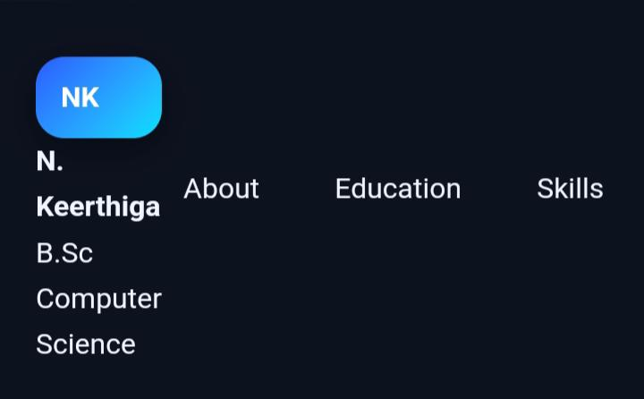
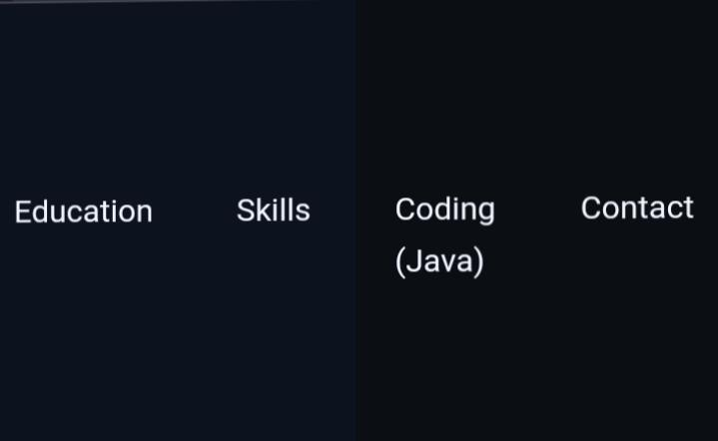

RESULT AND SCREENSHOT:

Slide 11
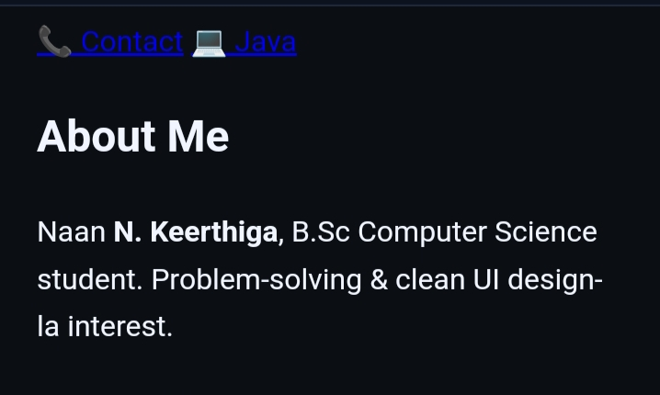
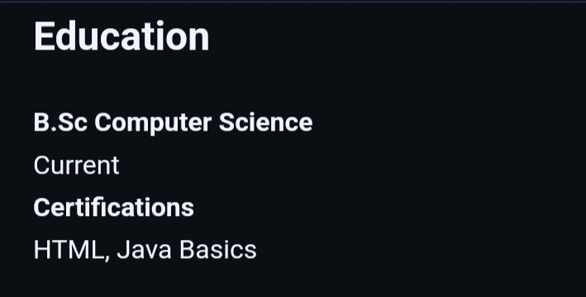
RESULT AND SCREENSHOT:

Slide 12
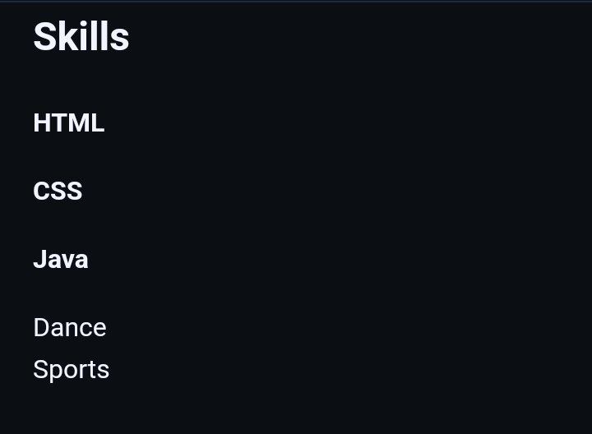
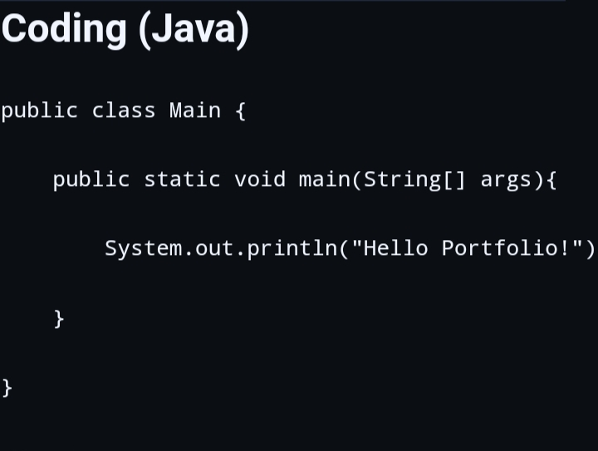
RESULT AND SCREENSHOT:

Slide 13
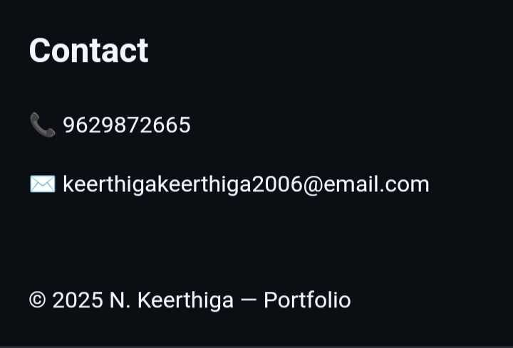
RESULT AND SCREENSHOT:

Slide 14
CONCLUSION:
What you learned from the project. Future improvements possible.

